Slide 1

Chapter 5
Analog Transmission
Copyright © The McGraw-Hill Companies, Inc. Permission required for reproduction or display.

Slide 2
5-1 DIGITAL-TO-ANALOG CONVERSION
Digital-to-analog conversion is the process of changing one of the characteristics of an analog signal based on the information in digital data.
Topics discussed in this section:
Aspects of Digital-to-Analog Conversion
Amplitude Shift Keying
Frequency Shift Keying
Phase Shift Keying
Quadrature Amplitude Modulation

Slide 3
Digital to Analog Conversion
Digital data needs to be carried on an analog signal.
A carrier signal (frequency f_{c}) performs the function of transporting the digital data in an analog waveform.
The analog carrier signal is manipulated to uniquely identify the digital data being carried.

Slide 4
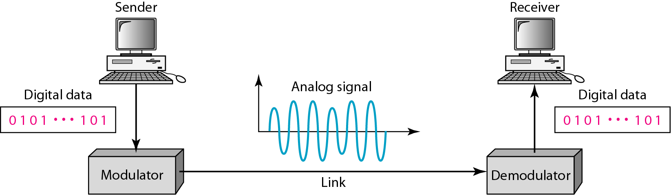
Figure 5.1 Digital-to-analog conversion

Slide 5
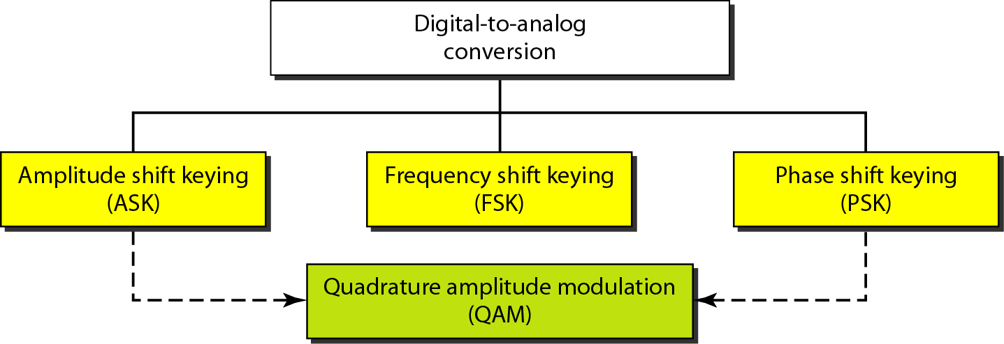
Figure 5.2 Types of digital-to-analog conversion

Slide 6

Note
Bit rate, N, is the number of bits per second (bps). Baud rate is the number of signal
elements per second (bauds).
In the analog transmission of digital data, the signal or baud rate is less than or equal to the bit rate.
S=Nx1/r bauds
Where r is the number of data bits per signal element.

Slide 7
Example 5.1
An analog signal carries 4 bits per signal element. If 1000 signal elements are sent per second, find the bit rate.
Solution
In this case, r = 4, S = 1000, and N is unknown. We can find the value of N from

Slide 8
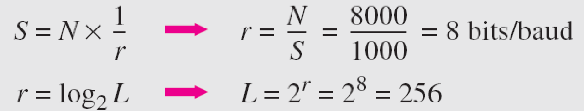
Example 5.2
An analog signal has a bit rate of 8000 bps and a baud rate of 1000 baud. How many data elements are carried by each signal element? How many signal elements do we need?
Solution
In this example, S = 1000, N = 8000, and r and L are unknown. We find first the value of r and then the value of L.

Slide 9
Amplitude Shift Keying (ASK)
ASK is implemented by changing the amplitude of a carrier signal to reflect amplitude levels in the digital signal.
For example: a digital “1” could not affect the signal, whereas a digital “0” would, by making it zero.
The line encoding will determine the values of the analog waveform to reflect the digital data being carried.

Slide 10
Bandwidth of ASK
The bandwidth B of ASK is proportional to the signal rate S.
B = (1+d)S
“d” is due to modulation and filtering, lies between 0 and 1.

Slide 11
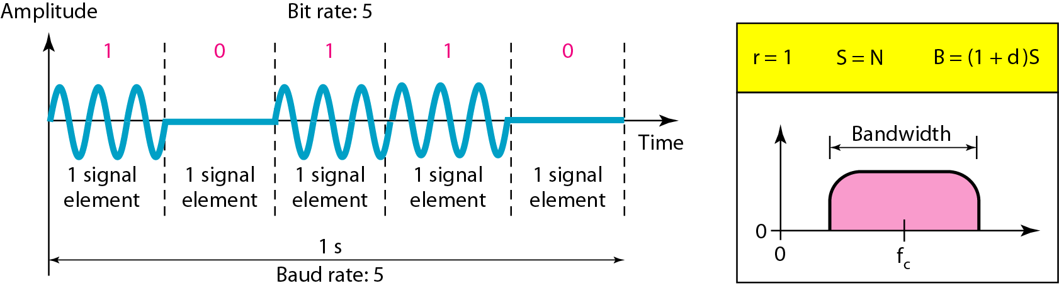
Figure 5.3 Binary amplitude shift keying

Slide 12
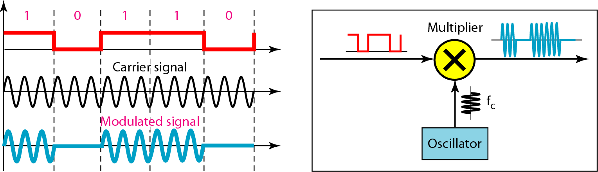
Figure 5.4 Implementation of binary ASK

Slide 13
Example 5.3
We have an available bandwidth of 100 kHz which spans from 200 to 300 kHz. What are the carrier frequency and the bit rate if we modulated our data by using ASK with d = 1?
Solution
The middle of the bandwidth is located at 250 kHz. This means that our carrier frequency can be at f_{c} = 250 kHz. We can use the formula for bandwidth to find the bit rate (with d = 1 and r = 1).

Slide 14
Example 5.4
In data communications, we normally use full-duplex links with communication in both directions. We need to divide the bandwidth into two with two carrier frequencies, as shown in Figure 5.5. The figure shows the positions of two carrier frequencies and the bandwidths. The available bandwidth for each direction is now 50 kHz, which leaves us with a data rate of 25 kbps in each direction.

Slide 15
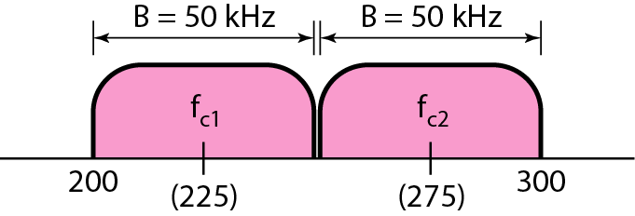
Figure 5.5 Bandwidth of full-duplex ASK used in Example 5.4

Slide 16
Frequency Shift Keying
The digital data stream changes the frequency of the carrier signal, f_{c}.
For example, a “1” could be represented by f₁=f_{c} +Δf, and a “0” could be represented by f₂=f_{c}-Δf.

Slide 17
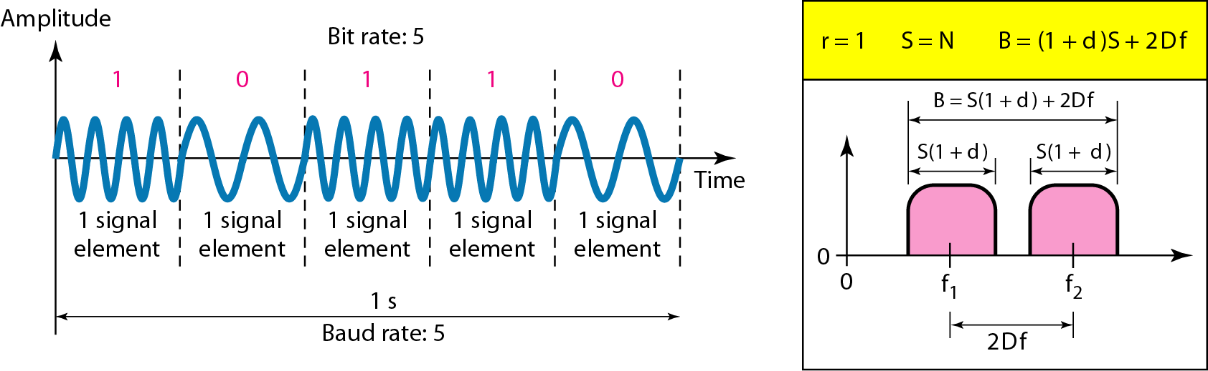
Figure 5.6 Binary frequency shift keying

Slide 18
Bandwidth of FSK
If the difference between the two frequencies (f₁ and f₂) is 2Δf, then the required BW B will be:
B = (1+d)xS +2Δf

Slide 19
Example 5.5
We have an available bandwidth of 100 kHz which spans from 200 to 300 kHz. What should be the carrier frequency and the bit rate if we modulated our data by using FSK with d = 1?
Solution
This problem is similar to Example 5.3, but we are modulating by using FSK. The midpoint of the band is at 250 kHz. We choose 2Δf to be 50 kHz; this means

Slide 20
Coherent and Non Coherent
In a non-coherent FSK scheme, when we change from one frequency to the other, we do not adhere to the current phase of the signal.
In coherent FSK, the switch from one frequency signal to the other only occurs at the same phase in the signal.

Slide 21
Multi level FSK
Similarly to ASK, FSK can use multiple bits per signal element.
That means we need to provision for multiple frequencies, each one to represent a group of data bits.
The bandwidth for FSK can be higher
B = (1+d)xS + (L-1)/2Δf = LxS

Slide 22
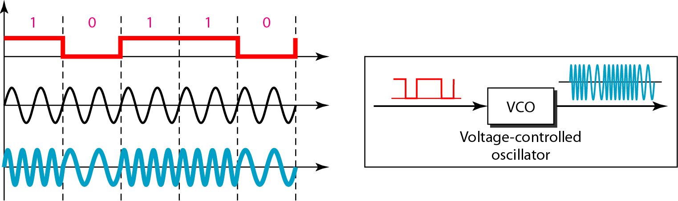
Figure 5.7 Bandwidth of MFSK used in Example 5.6

Slide 23
Example 5.6
We need to send data 3 bits at a time at a bit rate of 3 Mbps. The carrier frequency is 10 MHz. Calculate the number of levels (different frequencies), the baud rate, and the bandwidth.
Solution
We can have L = 2³ = 8. The baud rate is S = 3 Mbps/3 = 1 Mbaud. This means that the carrier frequencies must be 1 MHz apart (2Δf = 1 MHz). The bandwidth is B = 8 × 1M = 8M. Figure 5.8 shows the allocation of frequencies and bandwidth.

Slide 24
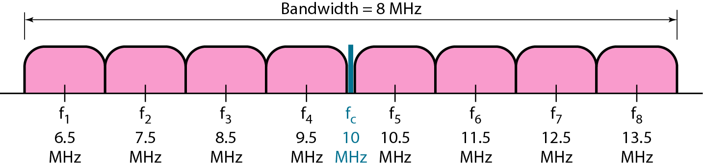
Figure 5.8 Bandwidth of MFSK used in Example 5.6

Slide 25
Phase Shift Keyeing
We vary the phase shift of the carrier signal to represent digital data.
The bandwidth requirement, B is:
B = (1+d)xS
PSK is much more robust than ASK as it is not that vulnerable to noise, which changes amplitude of the signal.

Slide 26
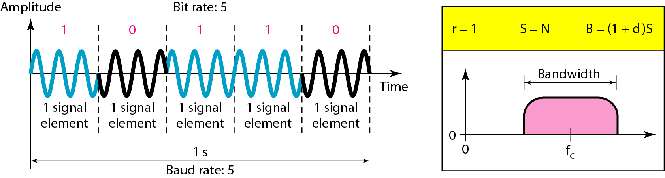
Figure 5.9 Binary phase shift keying

Slide 27
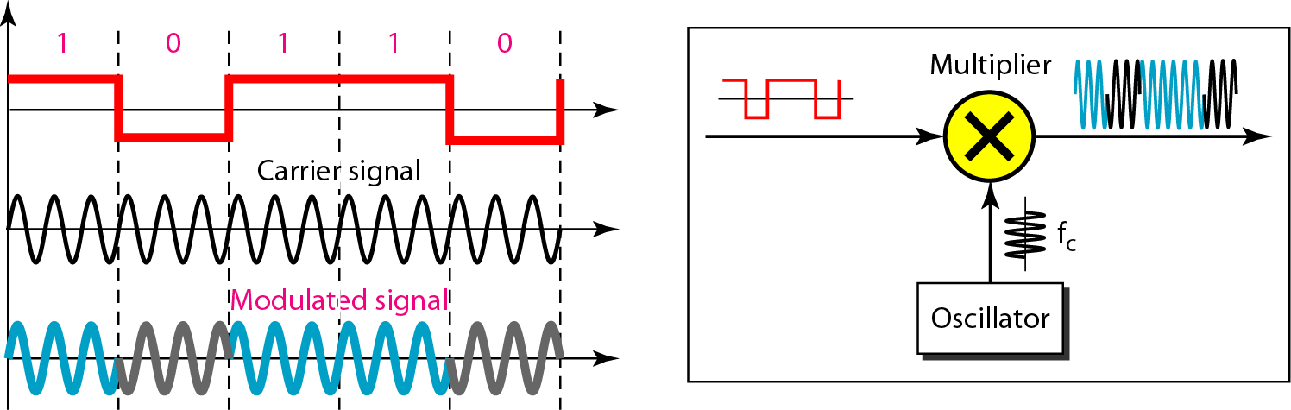
Figure 5.10 Implementation of BASK

Slide 28
Quadrature PSK
To increase the bit rate, we can code 2 or more bits onto one signal element.
In QPSK, we parallelize the bit stream so that every two incoming bits are split up and PSK a carrier frequency. One carrier frequency is phase shifted 90º from the other - in quadrature.
The two PSKed signals are then added to produce one of 4 signal elements. L = 4 here.

Slide 29
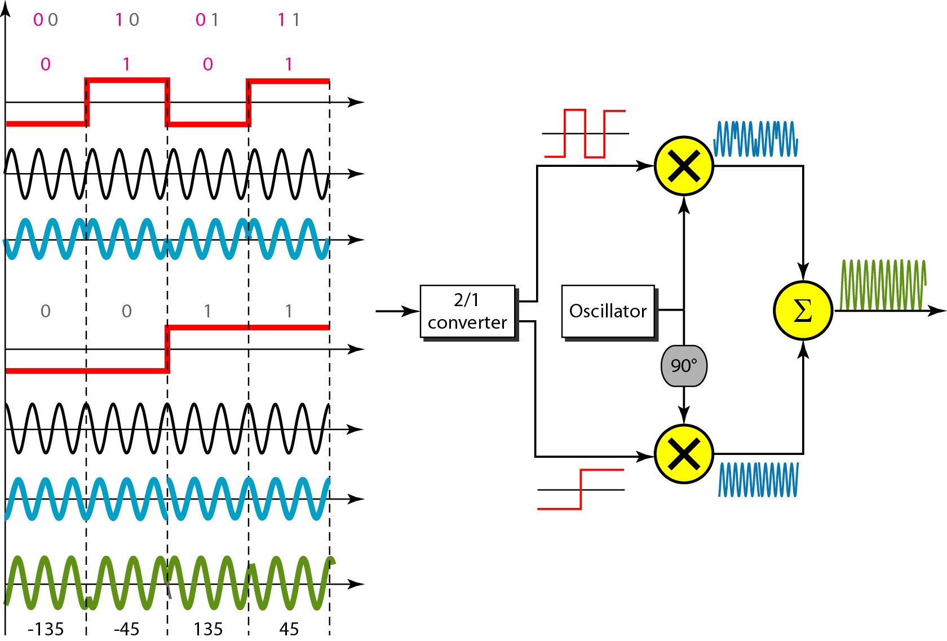
Figure 5.11 QPSK and its implementation

Slide 30
Example 5.7
Find the bandwidth for a signal transmitting at 12 Mbps for QPSK. The value of d = 0.
Solution
For QPSK, 2 bits is carried by one signal element. This means that r = 2. So the signal rate (baud rate) is S = N × (1/r) = 6 Mbaud. With a value of d = 0, we have B = S = 6 MHz.

Slide 31
Constellation Diagrams
A constellation diagram helps us to define the amplitude and phase of a signal when we are using two carriers, one in quadrature of the other.
The X-axis represents the in-phase carrier and the Y-axis represents quadrature carrier.

Slide 32
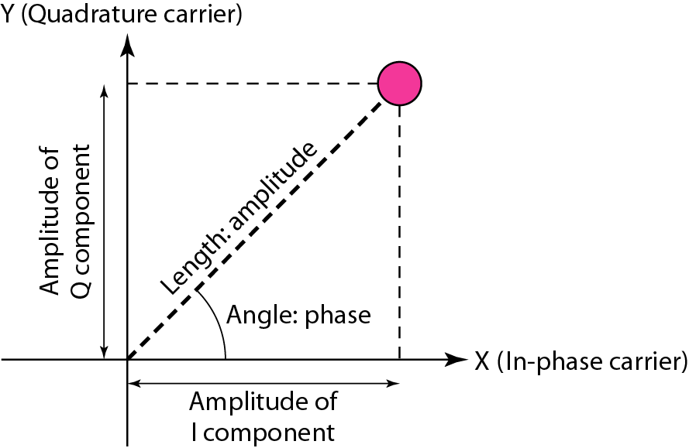
Figure 5.12 Concept of a constellation diagram

Slide 33
Example 5.8
Show the constellation diagrams for an ASK (OOK), BPSK, and QPSK signals.
Solution
Figure 5.13 shows the three constellation diagrams.

Slide 34
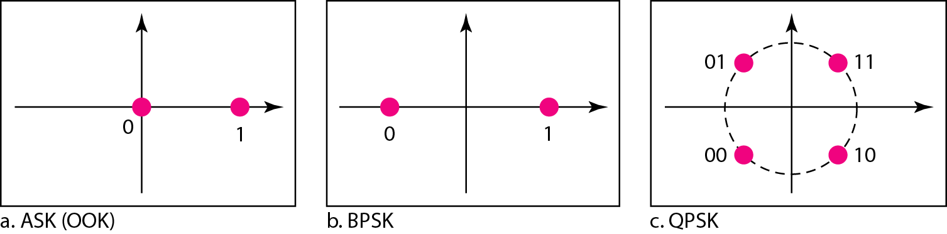
Figure 5.13 Three constellation diagrams

Slide 35
Note
Quadrature amplitude modulation is a combination of ASK and PSK.

Slide 36
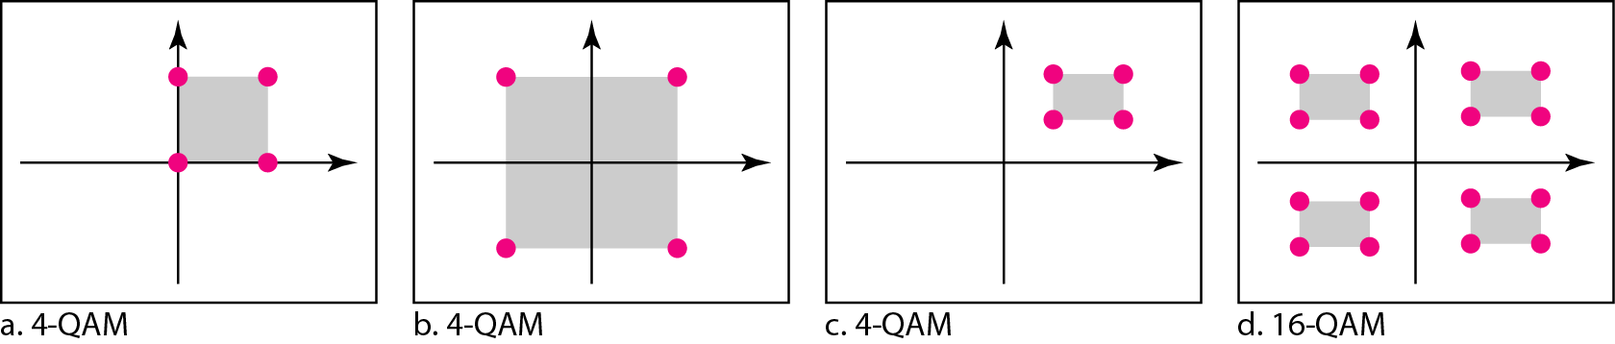
Figure 5.14 Constellation diagrams for some QAMs

